Slide 1
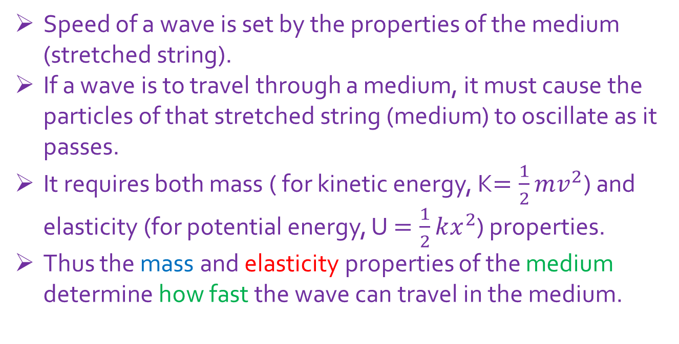
Lecture 18
16-2: Wave speed on a stretched string, v = $\sqrt{\frac{τ}{μ}}$
Speed of a wave is set by the properties of the medium (stretched string).
If a wave is to travel through a medium, it must cause the particles of that stretched string (medium) to oscillate as it passes.
It requires both mass ( for kinetic energy, K$=\frac{1}{2}mv^{2}$) and elasticity (for potential energy, U $=\frac{1}{2}kx^{2}$) properties.
Thus the mass and elasticity properties of the medium determine how fast the wave can travel in the medium.

Slide 2


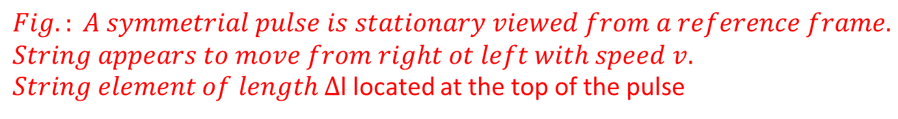












Derivation from Newton’s second law of motion, v = $\sqrt{\frac{τ}{μ}}$
+y
$$τcosθ$$
$$τcosθ$$
+x
$$θ$$
$$θ$$
$∆$l
$$τsinθ$$
$$τ$$
$$τsinθ$$
$$τsinθ$$
$$τ$$
𝜏𝑠𝑖𝑛$θ$
$$θ$$
$$θ$$
2$θ$
R
O
$$Fig.: A symmetrial pulse is stationary viewed from a reference frame.$$
$$String appears to move from right ot left with speed v.$$
$String element of length ∆$l located at the top of the pulse

Slide 3














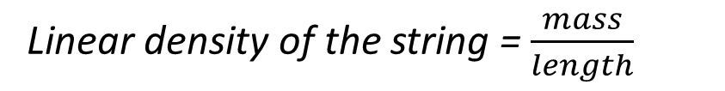


+y
$$τcosθ$$
$$τcosθ$$
+x
$$θ$$
$$θ$$
$∆$l
$$τsinθ$$
$$τ$$
$$τsinθ$$
$$τsinθ$$
$$τ$$
𝜏𝑠𝑖𝑛$θ$
$$θ$$
$$θ$$
2$θ$
R
O
1. Radial restoring force:
F = $τ sin{θ+τ sin{θ=2τ sin{θ=2τ{θ=τ(2{θ)=τ{ (\frac{∆l}{R})}}}}}}$
[If $θ$ is very small, sin$θ{≅tanθ≅θ and 2θ=\frac{∆l}{R} ] }^{}$
2. Mass of the element:
Linear density of the string = $\frac{mass}{length}$
$μ$ = $\frac{∆m}{∆l}$
$∆m$= $μ ∆l$

Slide 4
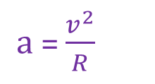
+y
$$τcosθ$$
$$τcosθ$$
+x
$$θ$$
$$θ$$
$∆$l
$$τsinθ$$
$$τ$$
$$τsinθ$$
$$τsinθ$$
$$τ$$
𝜏𝑠𝑖𝑛$θ$
$$θ$$
$$θ$$
2$θ$
R
O
3. Centripetal acceleration:
String element moves in an arc of a circle. It has a centripetal acceleration
toward the center of the circle.
$a$= $\frac{v^{2}}{R}$
Centripetal acceleration is given by

Slide 5
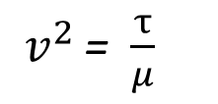
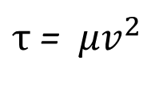
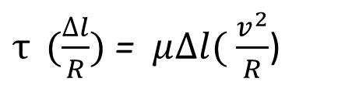

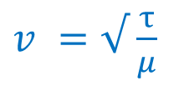
+y
$$τcosθ$$
$$τcosθ$$
+x
$$θ$$
$$θ$$
$∆$l
$$τsinθ$$
$$τ$$
$$τsinθ$$
$$τsinθ$$
$$τ$$
𝜏𝑠𝑖𝑛$θ$
$$θ$$
$$θ$$
2$θ$
R
O
Newton’s 2nd law of motion
F = $∆m$a
$τ{ (\frac{∆l}{R})}$ = $μ∆l($ $\frac{v^{2}}{R}$)
$τ$ = $μv^{2}$
The speed of a wave along a stretched ideal string
depends only on the tension and linear density
of the string and not on the frequency of the wave.
$v^{2 }$= $\frac{τ}{μ}$
$v^{ }=√$ $\frac{τ}{μ}$

Slide 6
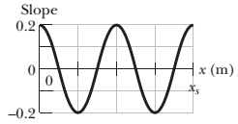
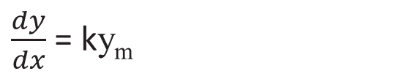
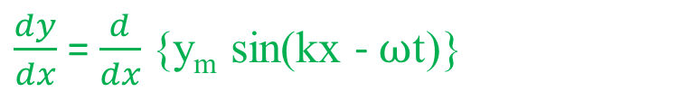
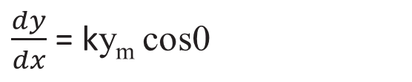
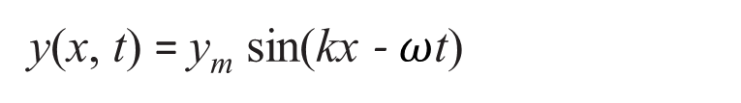
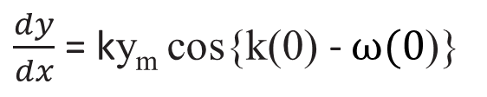
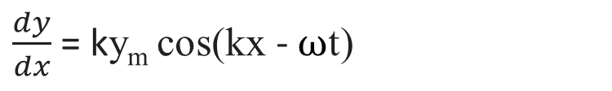
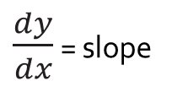
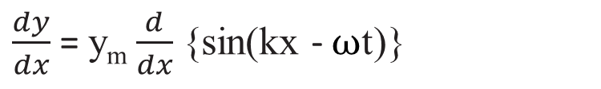
6. A sinusoidal wave travels along a string under tension. Figure gives the slopes along the string at time t = 0. The scale of the x axis is set by x_{s} = 0.80 m. What is the amplitude of the wave?
y(x, t) = y_{m} sin(kx - $ω$t)
$\frac{dy}{dx}$ = slope
$\frac{dy}{dx}$ = $\frac{d}{dx}${y_{m} sin(kx - $ω$t)}
$\frac{dy}{dx}$ = y_{m} $\frac{d}{dx}${sin(kx - $ω$t)}
$\frac{dy}{dx}$ = ky_{m} cos(kx - $ω$t)
At t = 0 and x =0,
$\frac{dy}{dx}$ = ky_{m} cos{k(0) - $ω(0$)}
$\frac{dy}{dx}$ = ky_{m} cos0
$\frac{dy}{dx}$ = ky_{m}

Slide 7
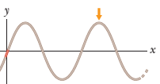

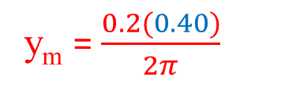
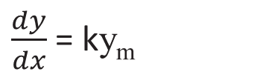
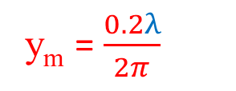

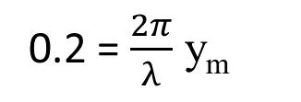
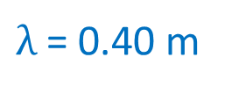
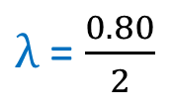
y(x, 0) = y_{m} sinkx
$\frac{dy}{dx}$ = ky_{m}
y(0, 0)= 0
Both graph t = 0
0.2 = $\frac{2π}{λ}$ y_{m}
y_{m} = $\frac{0.2λ}{2π}$
$From the Fig., λ$ = $\frac{\text{x}\text{s}}{2}$
$λ$ = $\frac{0.80}{2}$
$\frac{dy}{dx}$ = slope
$λ$ = 0.40 m
y_{m} = $\frac{0.2(0.40)}{2π}$
y_{m} = 0.01273 m = 1.27 cm

Slide 8
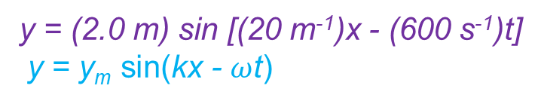
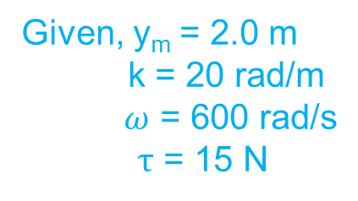
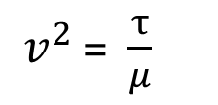
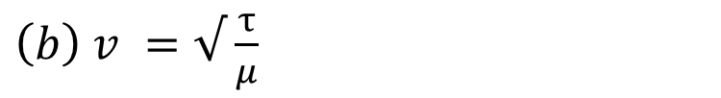
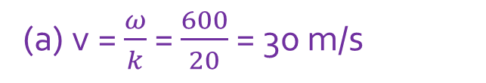
14. The equation of a transverse wave on a string is
y = (2.0 m) sin [(20 m⁻¹)x - (600 s⁻¹)t]. The tension in the string is 15 N. (a) What is the wave speed? (b) Find the linear density of this string in grams per meter.
y = (2.0 m) sin [(20 m⁻¹)x - (600 s⁻¹)t]
y = y_{m} sin(kx - $ω$t)
Given, y_{m} = 2.0 m
k = 20 rad/m
$ω$ = 600 rad/s
$τ$ = 15 N
(a) v = $\frac{ω}{k}$ = $\frac{600}{20}$ = 30 m/s
${\left(b\right) v}^{ }=√$ $\frac{τ}{μ}$
$v^{2 }$= $\frac{τ}{μ}$
$μ$= $\frac{τ}{v^{2}}$ = $\frac{15}{{(30)}^{2}}$ = 1.67x10⁻² kg/m = 16.7 gm/m

